Slide 1
Full Stack Web Development
MongoDB / NoSQL Explained

Slide 2
What is NoSQL?
A database that provides a different mechanism for storage than traditional tabular relations used in relational databases (RDBMS)
Does NOT mean “No SQL”. It means “Not Only SQL”
An alternative to SQL and can, in fact, apply SQL-like query concepts
Simplified design, horizontal scaling and finer control
Increasingly popular with “big data” and real-time web applications

Slide 3
Advantages of NoSQL
Big Data
No Explicit Schema
Scale Out Architecture (Horizontal Scaling)
Less Expensive
Less Management

Slide 4
Disadvantages of NoSQL
Maturity
Support & Community
Analytics & Business Intelligence

Slide 5

Horizontal Scaling (Out/In)
Add more nodes to a system
Add a new computer to a distributed system
Scaling from one web server to three
Hundreds of small computers can be configured in a “cluster”
Vertical Scaling (Up/Down)
Adding high end resources to a single node in a system
Resources may include CPU, memory, drives, etc
Uses virtualization technology more effectively

Slide 6
Types Of NoSQL Databases
Column: Cassandra, Hbase, Vertica
Document: MongoDB, CouchDB, Rethink
Key/Value: Couchbase, Dynamo, Memcached, Redis
Graph: Neo4J, MarkLogic

Slide 7
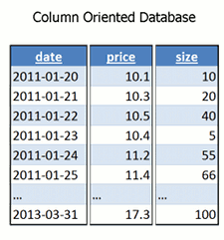
Column Database
A column of a distributed data store is a NoSQL object of the lowest level in a keyspace. It is a tuple (a key-value pair) consisting of three elements:
Unique name
Value
Timestamp

Slide 8
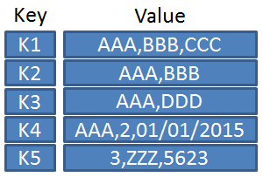
Key / Value Store
Data storage paradigm designed for storing, retrieving, and managing associative arrays, a data structure more commonly known today as a dictionary or hash

Slide 9
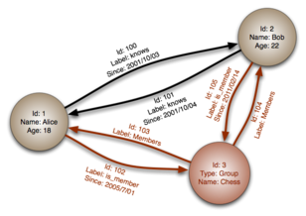
Graph Database
Database that uses graph structures for semantic queries with nodes, edges and properties to represent and store data. A key concept of the system is the graph (or edge or relationship), which directly relates data items in the store.

Slide 10
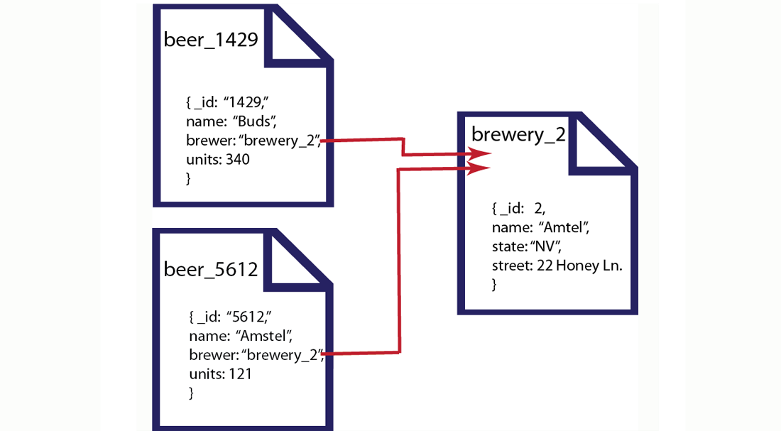
Document Database
Designed for storing, retrieving, and managing document-oriented information, also known as semi-structured data. Data is stored in JSON-like documents

Slide 11


